Slide 1
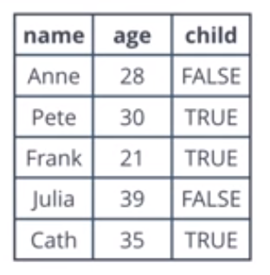
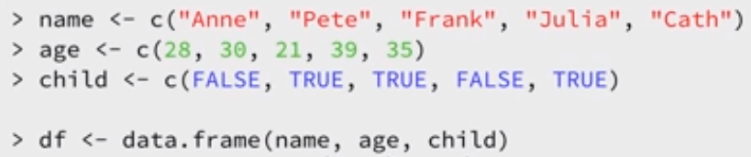
Data Frames

Slide 2
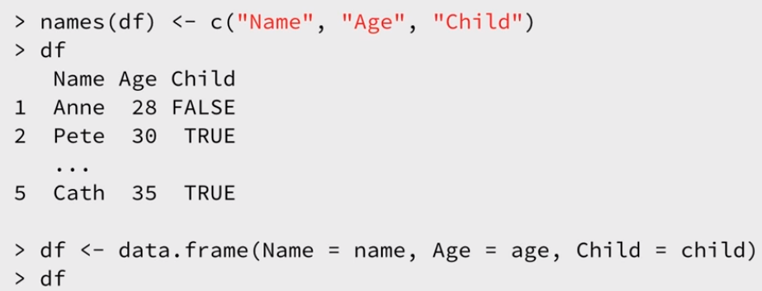

Slide 3
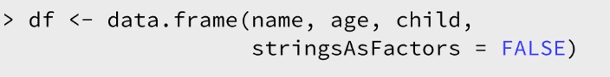
NOTE
R by default stores the strings as factors.
To suppress this behavior you can set the StringAsFactors argument of the data.frame

Slide 4
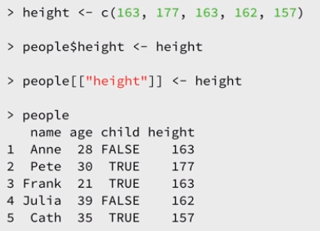
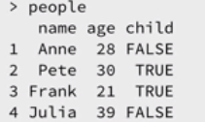
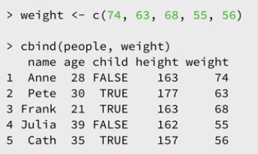
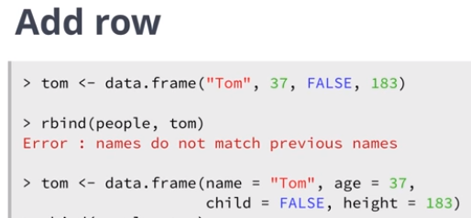
Add Columns and Rows

Slide 5
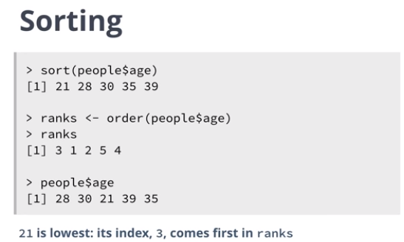

Slide 6
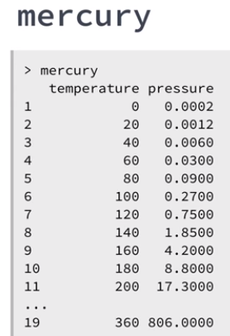
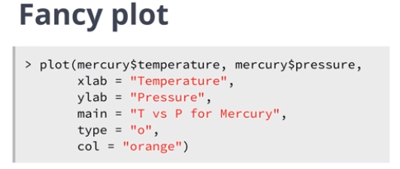
Plots

Slide 7
Measure of centre
When we numerically summarize a variable from our dataset in statistics, we want two main things.
1. We want to give them a measure of the variable's center,
2. measure of the variable's spread around that center.
when it comes to the measure of center.
We've got the mean, the median, and the mode.
For our measure of spread,
We have the candidates of Standard Deviation or the Interquartile Range (or IQR).
Headlines that include a measure of mean.
Average Workweek In America Is Actually Much Longer Than 40 Hours A Week
Average Student Debt Climbs To $29,000
House Prices Almost Five Times the Average, Local Salary
Sea Levels Rising In Antarctica Have Been Nearly A Third Faster Than The Global Average

Slide 8
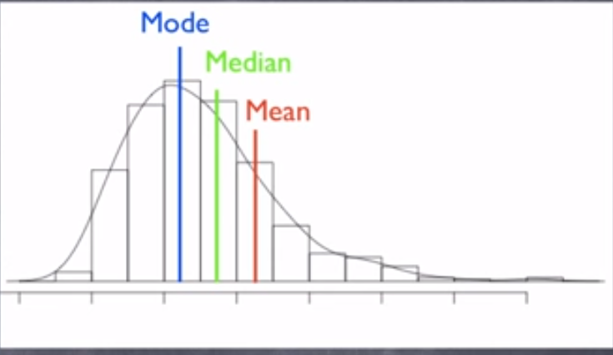
The shape of a distribution will push and pull the measurement of center around.
When the distribution is skewed to the right (or a positive skew), the mean gets pulled to the right and brings along with it the median.
The mode stays right where it is, at the peak of the data, at the most common occurring value.

Slide 9
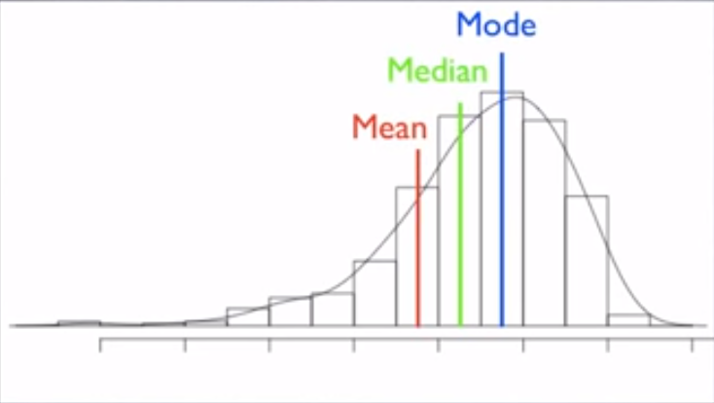
When the distribution is skewed to the left (or a Negative skew), the mean gets pulled to the left and brings along with it the median.
The mode stays right where it is, at the peak of the data, at the most common occurring value.

Slide 10
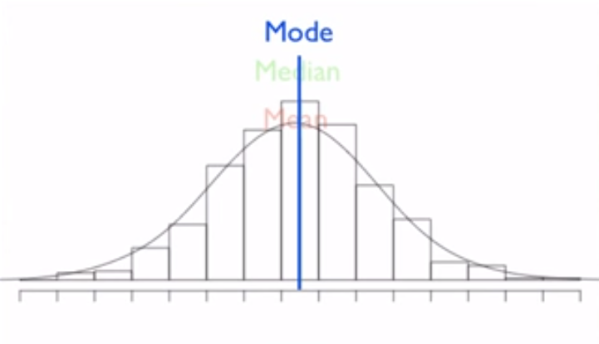
If we want a measure of center, and the distribution is symmetrical (it's not skewed in either direction), then the mean makes sense to use.
But if the distribution is skewed, then the mean turns out to be a bad idea.
With a positive skew →mean over estimates the measure of center.
With a negative skew → mean under estimates the central value of the distribution.

Slide 11
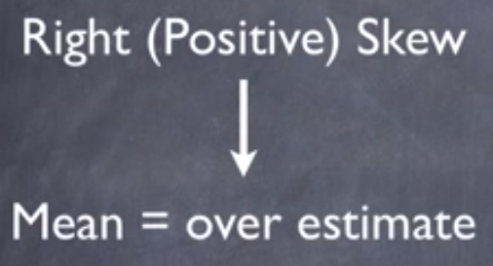
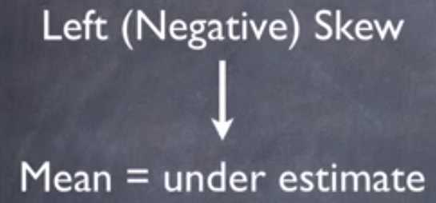
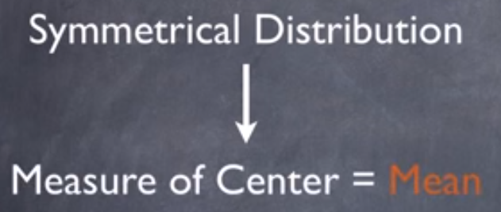

Slide 12
So which measure of center should we use?
A symmetrical variable distribution can use the mean.
If the distribution of the variable is skewed, then median is the measure of choice.
It's the measure of center that informs the center of the distribution without being too affected by the skew as the mean is.
Suppose we want to look at two subgroups and their data on the same variable, and one group shows a skewed distribution while the other is symmetrical.
If we want to compare the two subgroups, using the mean for the comparison, that would mean that one subgroup is misrepresented.
But, if we use the median instead, then the comparison is a little bit better.
The symmetrical subgroup is still the same value, and the measure of center for the skewed data is a better estimate.

Slide 13
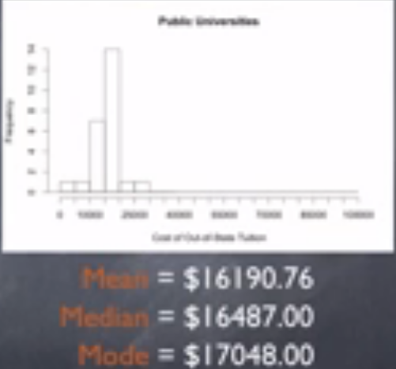
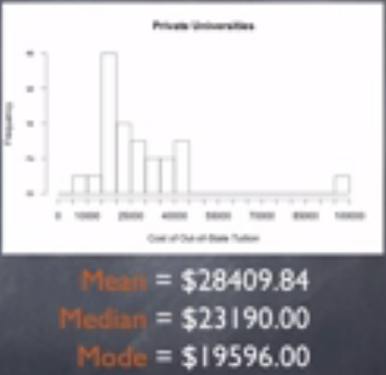
Symmetric
Skewed

Slide 14
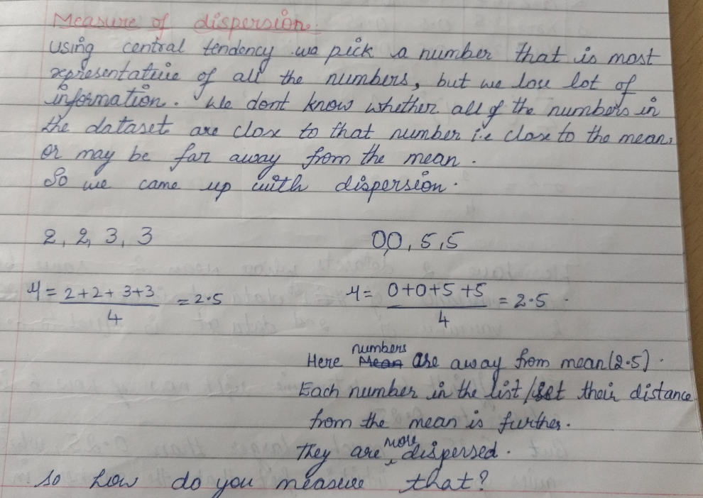

Slide 15
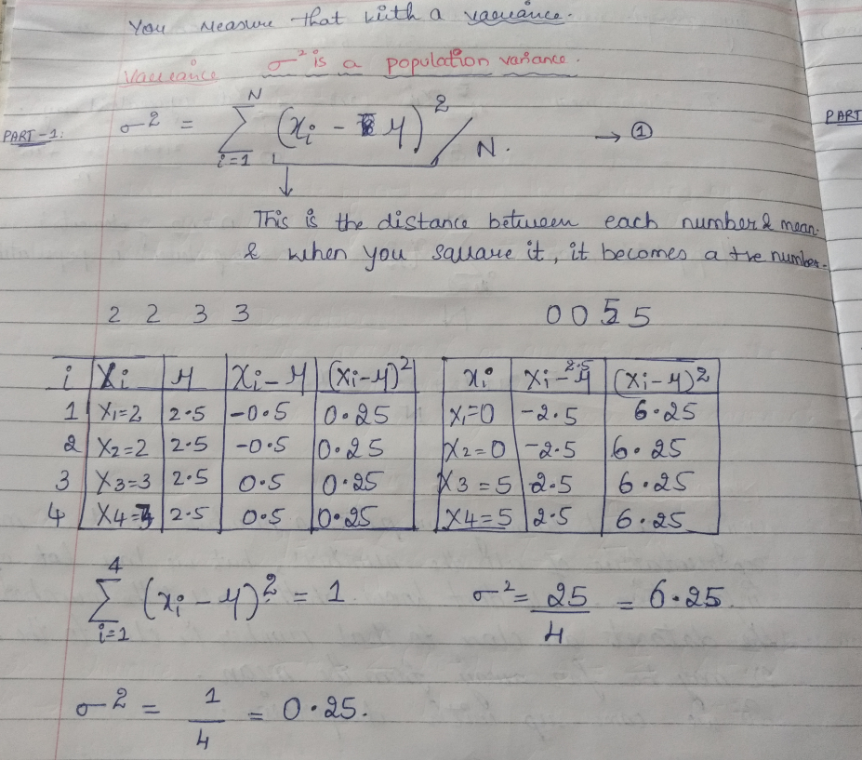

Slide 16
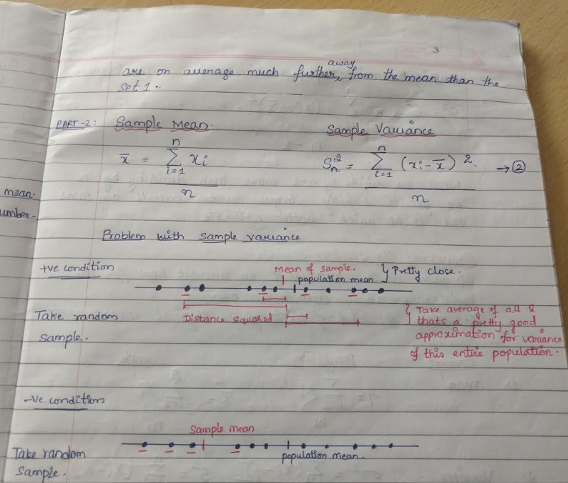

Slide 17
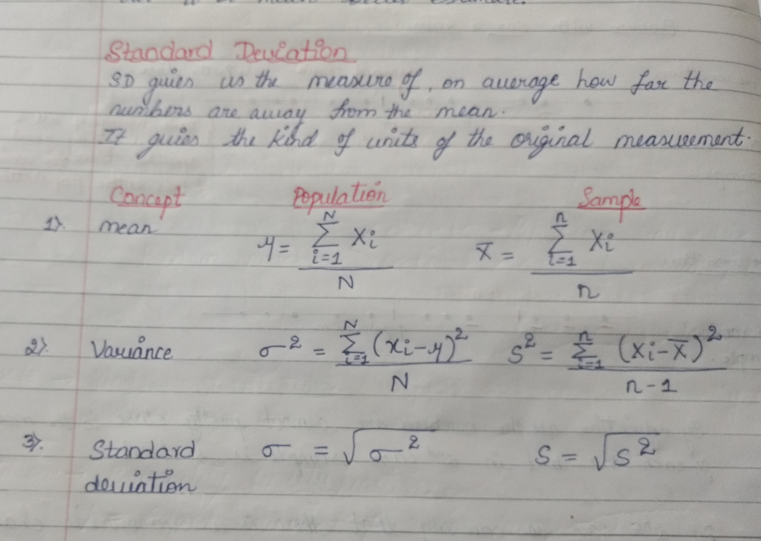

Slide 18
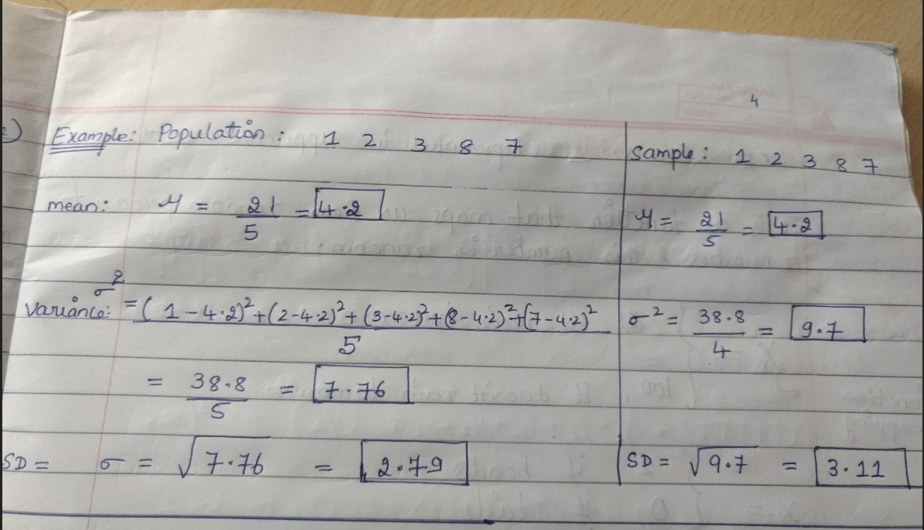

Slide 19
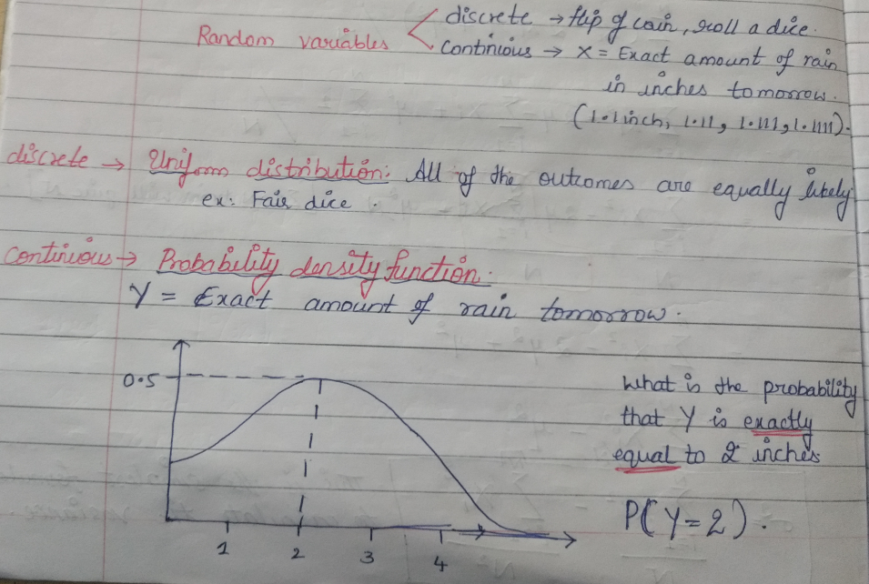

Slide 20
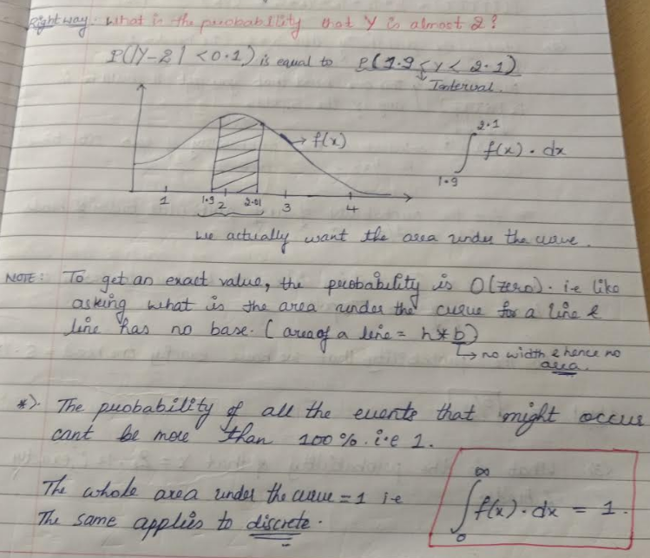

Slide 21
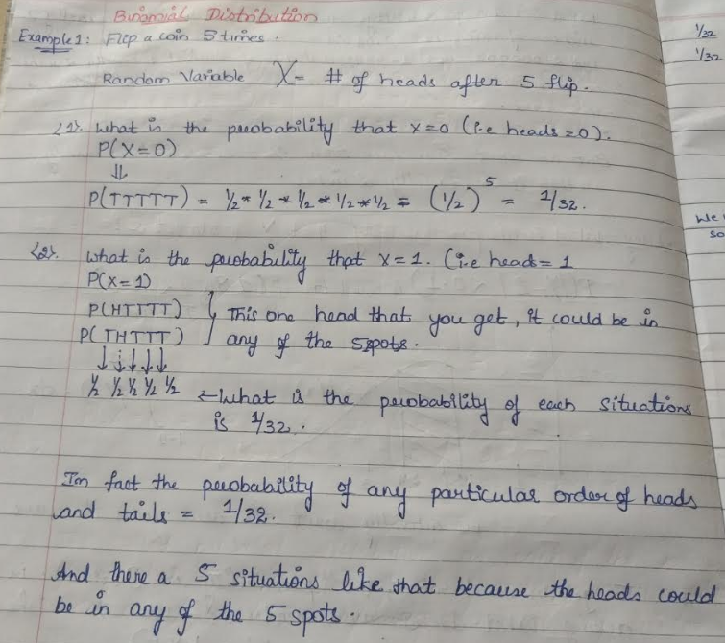

Slide 22
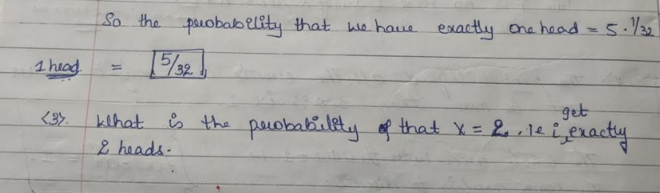

Slide 23
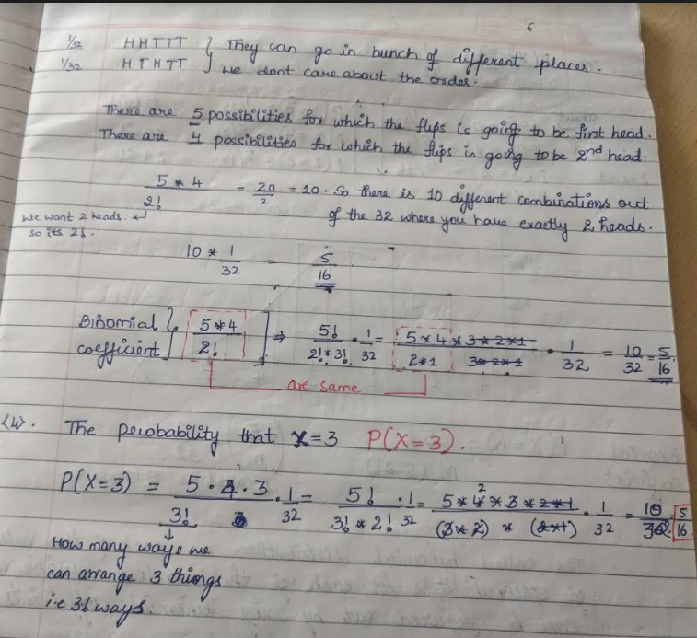

Slide 24
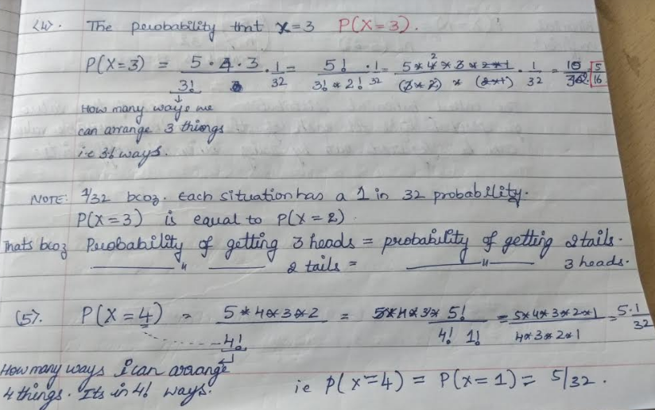

Slide 25
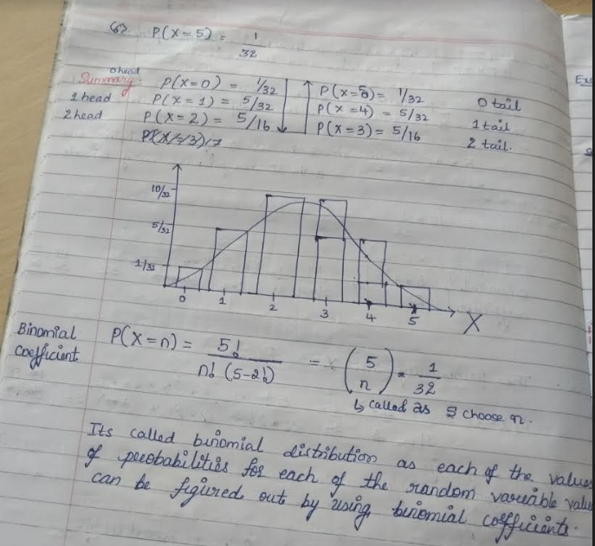

Slide 26
Poission Distribution

Slide 27
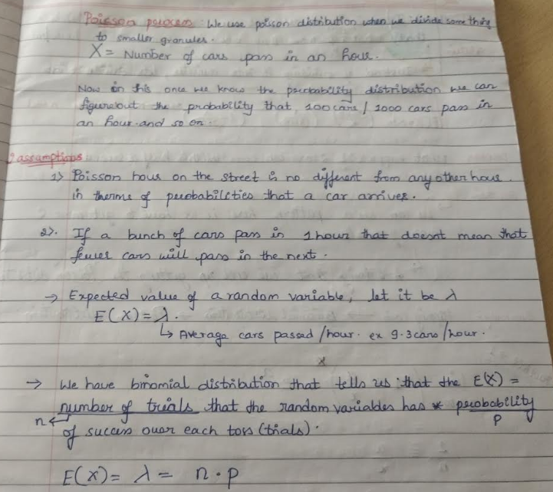
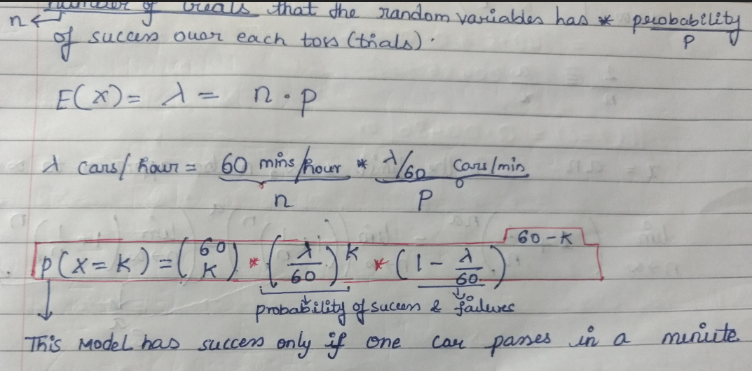

Slide 28
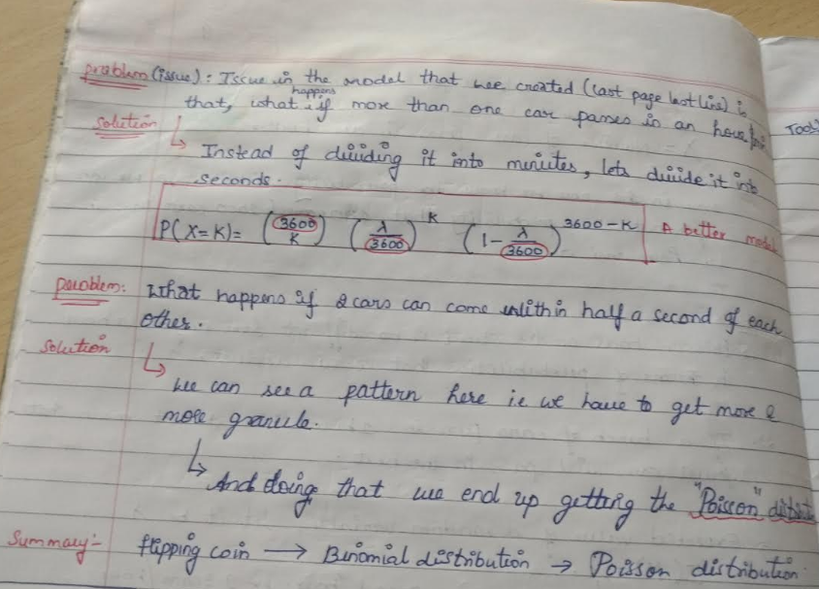

Slide 29
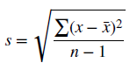
MEASURES OF SPREAD
The sample standard deviation is perhaps the most widespread measure of variability and is defined by
The standard deviation can be interpreted as the “typical” distance between a field value and the mean, and most field values lie within two standard deviations of the mean.

Slide 30
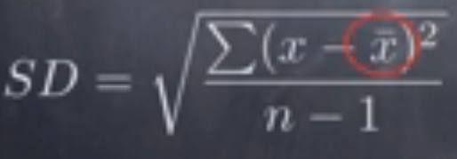
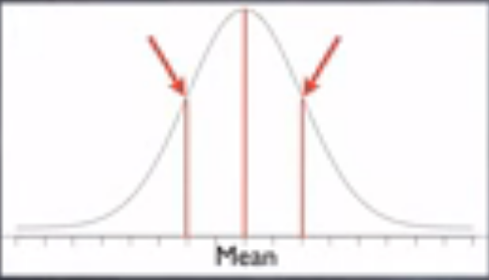
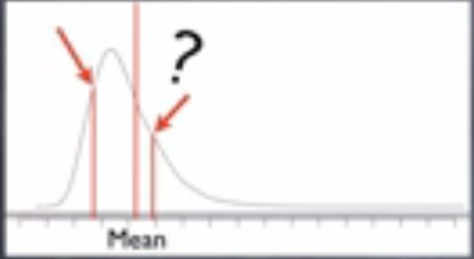
Measure of Spread
When the distribution is symmetrical, the Standard Deviation is a great measure of spread.
It gives us a measure of variability around the mean
And remember, with a skewed distribution, the mean is actually a poor choice to use.
And the mean is used in the calculation of Standard Deviation.
SD for Symmetrical Distribution SD for skewed Distribution

Slide 31
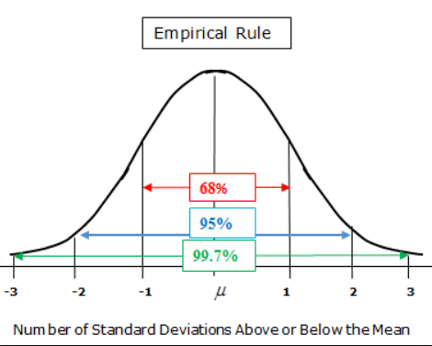
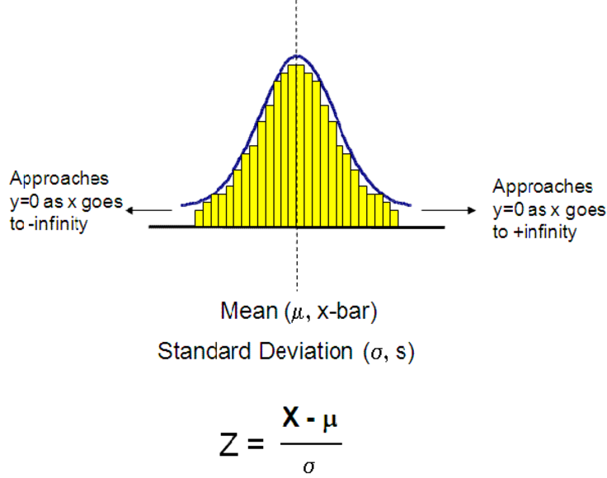
Notes:
Left Side is value below the mean and right side is value above the mean.

Slide 32
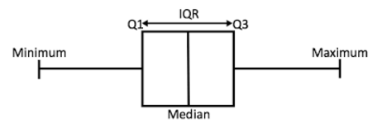
So we turn to the Interquartile Range (or IQR).
This measure of spread is the difference between the 1st and the 3rd quartiles, which are informed by the median - the preferred measure of center for a skewed distribution.

Slide 33
So, to answer our question, because a visual inspection of the distribution for both groups shows both symmetrical and skewed data, we use the median for both - the stable measure.
Private universities have a higher out-of-state tuition than Public schools.
The median cost for a Public school is $16,500 while for a Private school that cost is around $23,000.
We used median for both. The stable measure

Slide 34
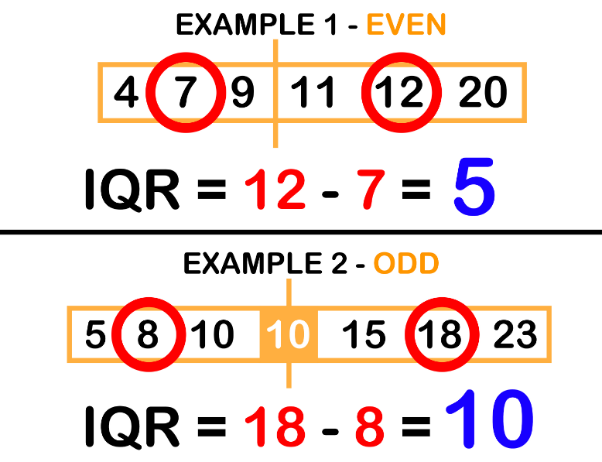
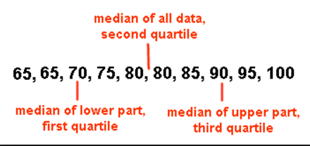
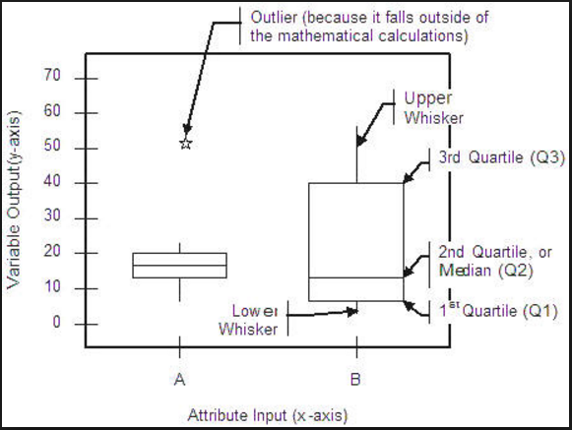
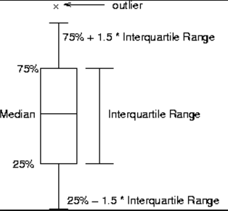

Slide 35
Outlier for standard deviation
Lower fence = Mean - (Standard deviation * multiplier)
Upper fence = Mean + (Standard deviation * multiplier)

Slide 36
MEASURES OF CENTER AND SPREAD
The mean is sensitive to the presence of outliers
median, defined as the field value in the middle when the field values are sorted into ascending order. The median is resistant to the presence of outliers.
mode may be used with either numerical or categorical data, but is not always associated with the variable center.

Slide 37
IQR (How to identify an outlier)
Calculate first quartile (Q1), third quartile (Q3) and the interquartile range. (IQR=Q3-Q1).
Example: Q1=0.9, Q3=6.05, IQR=5.15.
Compute Q1–1.5 × IQR = –6.825
Compute Q3+1.5 × IQR =13.775
Anything outside this range is an outlier.

Slide 38
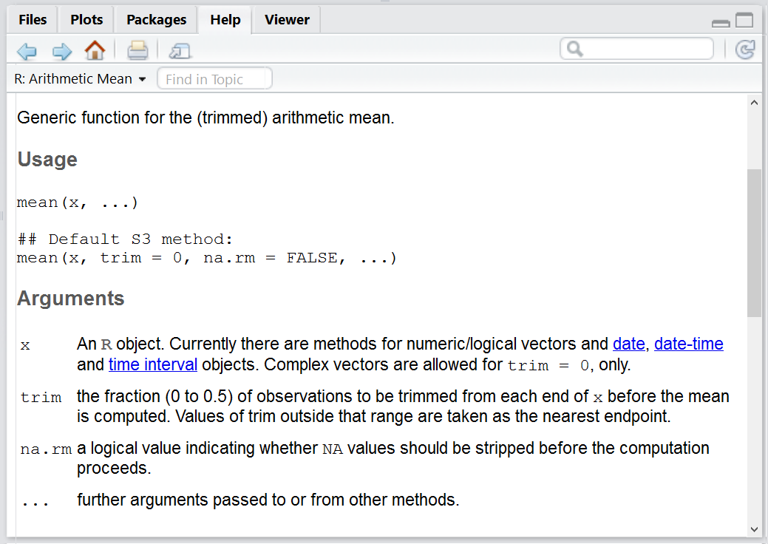

Slide 39
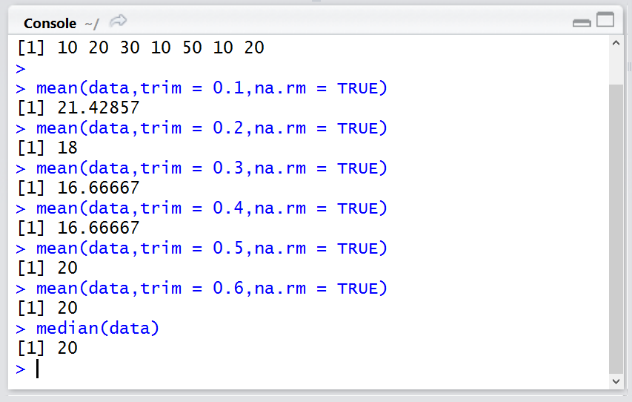

Slide 40
x = c(1,2,3,4,5,6,7,8,9,45)
xm = mean(x, trim=0.10)
x = c(1,2,3,4,5,6,7,8,9,45,NA)
xm = mean(x, trim=0.0, na.rm=TRUE)
Using trimmed means confers two advantages:
Trimmed means provide a better estimation of the location of the bulk of the observations than the mean when sampling from asymmetric distributions.
The standard error of the trimmed mean is less affected by outliers and asymmetry than the mean, so that tests using trimmed means can have more power than tests using the mean.

Slide 41
Visualization
Some basic visualizations of categorical data are bar charts or pie charts.
For numerical data of one variable, we can use a dot plot, a stem and leaf plot, or the histogram.

Slide 42
We've got data on driving preference during inclement weather and here's a description of each of the variables.
Our variable of "Choice to Drive" ranges from "Always" to "Never."
The number of rows that have an "Always" in it in the column of "Choice to Drive" is 8, while the number of rows that have an "Almost Always" in the column of "Choice to Drive" is 7.
Because the variable is categorical, we call this a "Table of Counts or contingency table."
i.e we go from actual data → to summary table→ bar graph
Notes:
The rows in the data set which says always is 8. So choice to drive is a categorical variable.

Slide 43
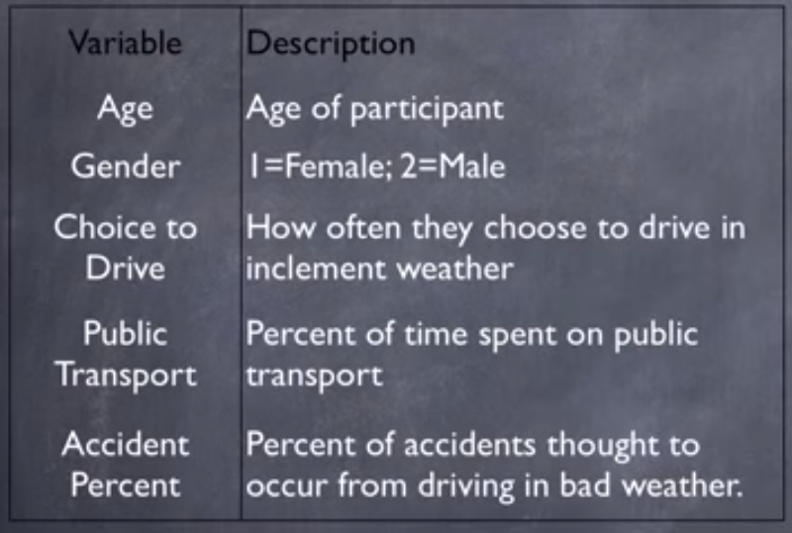

Slide 44
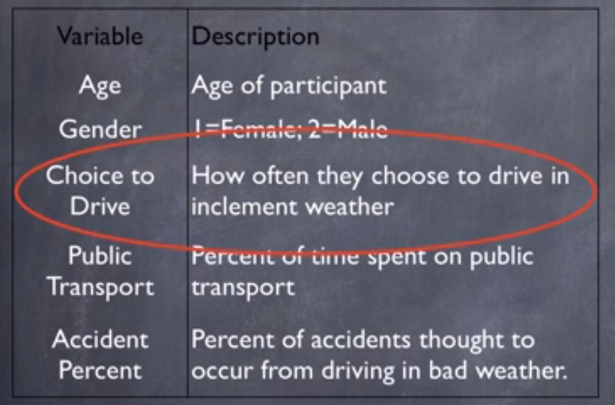

Slide 45
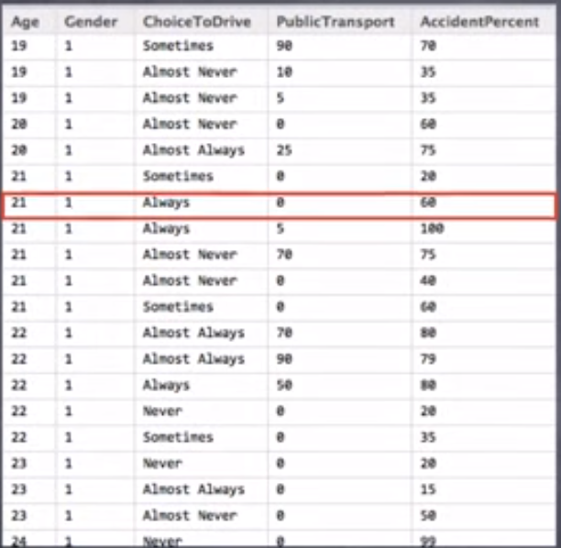

Slide 46


Slide 47


Slide 48



Value | Count (Frequency)
Always | 8
Almost Always | 7
Sometimes | 14
Almost Never | 13
Never | 13

Slide 49

Visualizing Univariate data
Import AnimalData.csv into R studio
Use head() to see the contents of the dataset
So we've got a large variety of both categorical and numeric data in this dataset.

Slide 50


Visualize a Categorical Variable
So let's take the categorical variable for the gender of the animal, called sex.
Let's say we want to see how many males and how many females are in our data set.
> abc=table(AnimalData$Sex) > barplot(abc,main="BarPlot", xlab = "Animal Gender", ylab = "Frequency")

Slide 51

Pie chart (Categorical)
> lbls = c("Female","Male")
> pie(abc,labels = lbls, col =rainbow(length(lbls)))

Slide 52


visualize a numeric variable
So let's look at this Age at Intake variable here, which is how old each animal was when it was brought into the shelter.
So we see there is an old female dog, about 10 years old, when it entered the shelter. And then we have puppies or kittens that are not even a year old yet that have an age of intake of 0.
So if we want to visualize the distribution of this numeric variable, we can do that with a histogram.
So this distribution is what we would call a right skew or positive skew distribution.

Slide 53



Create a histogram for different groups.
Create two histograms of the age of intake variable by splitting up the data set into male animals and female animals using the gender variable.

Slide 54

hist(femalage,main = "Histogram of Female Ages",xlab="Age at Intake of Female Animals",breaks = 15)
We would see that there is one case way far away from the other cases that we might want to go investigate which we would have missed if we had just stuck with our original default histogram.
So sometimes it's a good idea to adjust the number of breaks in your histogram just to see if there's anything that jumps out at you with more or fewer bins.

Slide 55

If we wanted to go find out the information from this animal here that was much older than any of the other animals when it entered the shelter, we can do that with a function called "which“ and which will pull out a case from your data frame that follows a certain condition.

Slide 56
How to run various descriptive statistics on a single numerical variable.
we're going to be specifically looking at the age-at-intake variable, which is how old these animals were when they arrived at the shelter.
So there are a couple different measures of the center of a numeric distribution that we're going to learn how to calculate.
So along with the measure of center, we typically want to talk about the spread, or the amount of variability in a variable.

Slide 57

Another way to describe the amount of spread in a variable is to report the five-number summary, which consists of the minimum, the maximum, the median or halfway point, and then also the first and third quartiles, which are what you use to calculate the interquartile range, which is sometimes reported as a measure of spread.

Slide 58


Slide 59
Z-SCORE

Slide 60
Z-Score
Question: Can we compare the performance of 2 students from two separate classes, who took an exam on the same material?
Answer is yes - as long as we were confident that the exams were close in material and difficulty.
Then we could simply compare the actual values: Kiran got an 83 while Nikitha got an 89, so Nikitha performed better on the exam.
But what if the exams were NOT all that similar? Could we compare kiran and Nikitha then?
The answer is yes.
We can do it with the help of z-scores.
You see, z-scores has same basic ruler regardless of scale.

Slide 61


First, we start with the difference between a single score and the mean of the distribution that that score came from.
For Kiran, the mean of his distribution (or his class) was 74, while for Nikitha her mean was 80.
Kiran = 83 - 74
Nikitha = 89 - 80
Both Kiran and Nikitha show a difference to the mean of 9 points. But that's not the whole story: each distribution has a measure of center and a measure of SPREAD.
In our case, because we're assuming a normal, symmetrical, distribution, the Standard Deviation is the measure of choice for spread.
We take the difference that we've already found, and we divide by the Standard Deviation of each distribution.
Kiran's distribution Standard Deviation is 4, while for Nikitha, her distribution Standard Deviation is 6.
(83 – 74)/4 = 2.25
(89 – 80)/6 = 1.5

Slide 62
So, if we solve for both z-scores, we find that Kiran’s z-score of exam performance is 2.25, while for Nikitha, her z-score for her performance is 1.5.
So, who performed better?
Well Nikitha got a HIGHER raw score, but her class did better overall (maybe it was just an easier exam).
And more importantly, Nikitha's class had a larger SD. It had more spread around the mean.
So on the "ruler" of performance - Kiran was 2.25 units better than average, while, for Nikitha, she was only 1.5 units better than average.
And we call these particular units z-scores.

Slide 63
Now it turns out that the normal distribution, this wonderful curve, has some really stable properties that allow us to find out the percentage of cases that fall both above or below or inside or outside particuliar z-scores.
Here's the empirical rule: it's a great rough guideline to start with when it comes to area under the curve.
Here's where the first Standard Deviation falls (right about where the curve changes).
The empirical rule says that 68% of the cases in this distribution will fall between these first Standard Deviations, of -1 and +1 for a z-score (one Standard Deviation below and 1 Standard Deviation above the mean).
95% of the cases will fall between -2 and +2 in terms of z scores or Standard Deviations
99.7% will fall between -3 and +3.
In actuality, we can find the proportion under the curve for ANY z-score we wish.

Slide 64

Notes:
Left Side is value below the mean and right side is value above the mean.

Slide 65



Let's take a look at Kiran and Nikitha again.
Here's Nikitha's score of 89 and here is her assumed normal distribution with a mean of 80 and a Standard Deviation of 6. And here's her corresponding z-score of 1.5.
Using a z-table or a function in R, we can find that roughly 7% of her class performed better than her.
While for John, on the other hand, with his specific distribution and his z score, we can see that only 1% performed better than him.

Slide 66


Proportion under the curve

Slide 67

Adv of Z score is it work on any distribution scale.
If jhons exam was out of 100 and Jaynes exam was out of 75 then we can still do it, by calculating the Z-score first.

Slide 68
So, if we wanted to see who preformed better on an exam where kiran's exam was actually out of 100 and Nikitha's exam was out of 75 points, we could STILL do it.
We simply convert to z-scores first.
So, to answer our question of who did better on the exam, and get the added bonus of finding the percent of distribution that reflects that performance, we can use z-scores.

Slide 69
Let's take a look at the variable of "Accident" - the percent of accidents THOUGHT to occur from driving in inclement weather.
This is a belief question.
"Can we visually summarize the participant's belief about accidents during inclement weather?“ Yes- with another table.
Since this new variable has a large span (from 0 to 100), we'll use Grouped Frequency Table.
Grouped because the variable's range is so large, and we want to chunk or bin the data into smaller, more manageable ranges.
Most of the time we want to shoot for about 10 bins in our frequency tables or 10 rows. So let's chunk our data by 10.

Slide 70
Just like we did with categorical data, we want to count the number of rows that fit a certain criteria.
The number of rows that fit the 0 to 10% bin is 3; the number of rows that fit the 10 to 20% bin is 2 and so on. And now, we can make what's called a histogram.
Both the bar graph and the histogram COUNT the number of rows (or frequency), that a variable had a certain value afforded.
For the bar graph, that value is a category, and we show that by the separation of the bars in the graph.
But for a histogram, that value is numerical, and it's usually continuous.

Slide 71




Slide 72
How to run various descriptive statistics on a single numerical variable.
we're going to be specifically looking at the age-at-intake variable, which is how old these animals were when they arrived at the shelter.
So there are a couple different measures of the center of a numeric distribution that we're going to learn how to calculate.
So along with the measure of center, we typically want to talk about the spread, or the amount of variability in a variable.

Slide 73
Another way to describe the amount of spread in a variable is to report the five-number summary, which consists of the minimum, the maximum, the median or halfway point, and then also the first and third quartiles, which are what you use to calculate the interquartile range, which is sometimes reported as a measure of spread.

Slide 74

1. Number of bins
R chooses how to bin your data for you by default using an algorithm.
We can see that right now from the output below that the breaks go from 17 to 32 by 1.
Use the breaks() option to change this in a number of ways.
hist(BMI, breaks=20, main=”Breaks=20″) hist(BMI, breaks=5, main=”Breaks=5″)

Slide 75

The bins don’t correspond to exactly the number you put in, because of the way R runs its algorithm to break up the data but it gives you generally what you want.
If you want more control over exactly the breakpoints between bins, you can be more precise with the breaks() option and give it a vector of breakpoints.
hist(BMI, breaks=c(17,20,23,26,29,32), main=”Breaks is vector of breakpoints”)

Slide 76
Give the breaks vector as a sequence like this to cut down on the messiness of the code:
hist(BMI, breaks=seq(17,32,by=3), main= ”Breaks is vector of breakpoints”)
When giving breakpoints, the default for R is that the histogram cells are right-closed (left open) intervals of the form (a,b].
You can change this with the right=FALSE option, which would change the intervals to be of the form [a,b).
This is important if you have a lot of points exactly at the breakpoint.

Slide 77
When creating histograms of non-categorial data (things like pH, temperature, etc.), you need to specify things called "bins".
Each bin has something called an interval specified for it. For example, if I have the data:
11 12 13 14 15 16 17 18 19
I can create 5 bins with right-open, left-closed intervals like this:
1st bin: [10, 12)
2nd bin: [12, 14)
3rd bin: [14, 16)
What this means is that the first bin will "hold" values between 10 and 12, including 10 but not including 12.
1st bin: 10 ≤ x < 12
2nd bin: 12 ≤ x < 14
3rd bin: 14 ≤ x < 16

Slide 78
So that means the values 11 will go into the 1st bin, but the value 12 will go into the second bin, etc. R will do this binning process for you then draw the histogram based on how many items are in each bin.
For the above data, you'll get a rather not-interesting histogram that is mostly flat except at the first bin.
(1, 4) --> 1 < x < 4 left-open, right-open
[3, 7) --> 3 ≤ x < 7 left-closed, right-open
(2, 9] --> 2 < x ≤ 9 left-open, right-closed
[5, 6] --> 5 ≤ x ≤ 6 left-closed, right-closed
(-∞, ∞) --> -∞ < x < ∞
(-∞, 20] --> -∞ < x ≤ 20
[20, ∞) --> 20 ≤ x < ∞
(1000, ∞) --> 1000 < x < ∞
(-∞, ∞] --> Invalid
(41, ∞] --> Invalid

Slide 79

2. Frequency vs Density
Often, we are more interested in density than frequency, since frequency is relative to your sample size.
Instead of counting the number of datapoints per bin, R can give the probability densities using the freq=FALSE option
hist(BMI, freq=FALSE, main=”Density plot”)

Slide 80

Notice the y-axis now. If the breaks are equidistant, with difference between breaks=1, then the height of each rectangle is proportional to the number of points falling into the cell, and thus the sum of the probability densities adds up to 1.
Here I specify plot=FALSE because I just want the histogram output, not the plot, and show how the sum of all of the densities is 1:

Slide 81

If you choose to make bins that are not all separated by 1 (like breaks=c(17,25,26, 32) or something like that), then the plot still has an area of 1,
But the area of the rectangles is the fraction of data points falling into the cells.
The densities are calculated like this as counts/(n*diff(breaks)).
Thus, this adds up to 1 if add up the areas of the rectangles, i.e. you multiply each density by the difference in the breaks like this:

